Slide 1
Data structures and algorithm
Graphs
Dr. Seemab Latif
Lecture No. 14
31st December , 2010

Slide 2
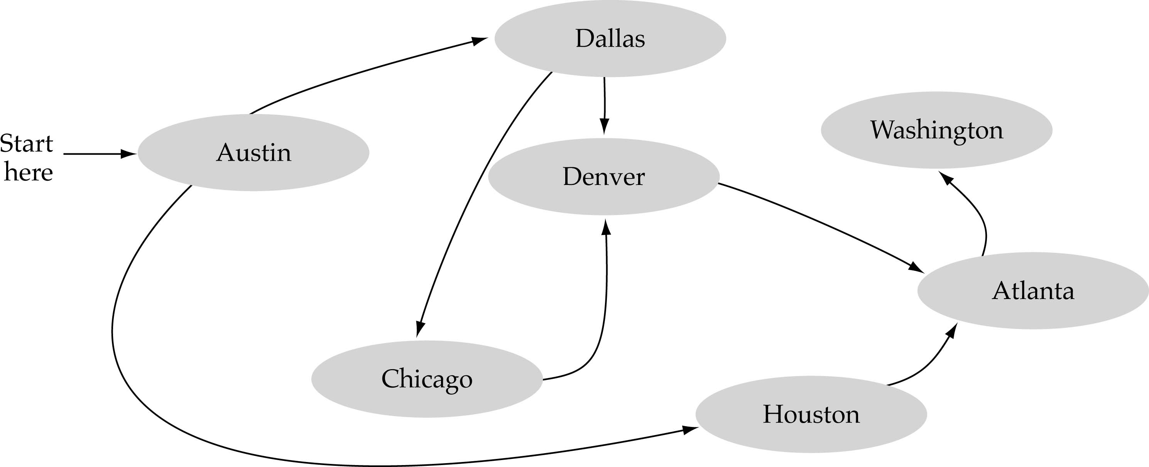
What is a graph?
A data structure that consists of a set of nodes (vertices) and a set of edges that relate the nodes to each other.
The set of edges describes relationships among the vertices.

Slide 3
Formal definition of graphs
A graph G is defined as follows:
G=(V,E)
V(G): a finite, nonempty set of vertices
E(G): a set of edges (pairs of vertices)

Slide 4
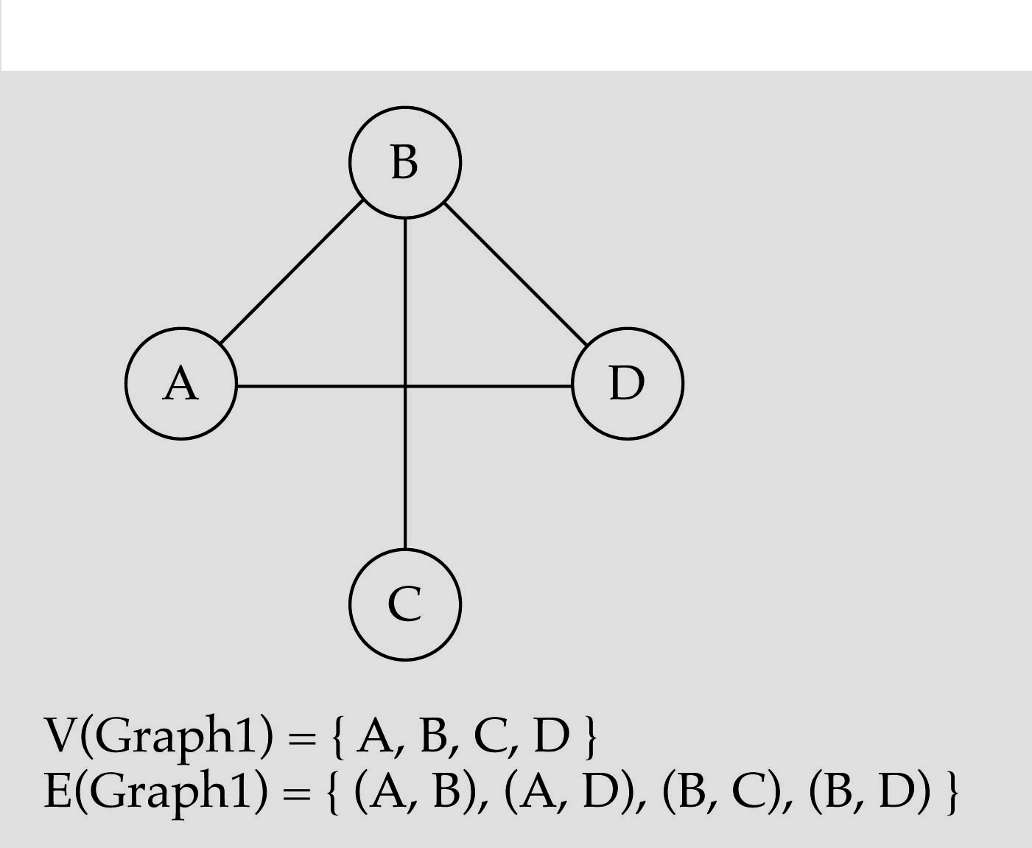
Directed vs. undirected graphs
When the edges in a graph have no direction, the graph is called undirected

Slide 5
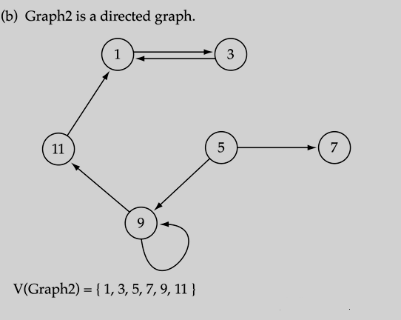
Directed vs. undirected graphs (cont.)
When the edges in a graph have a direction, the graph is called directed (or digraph)
if the graph is directed, the order of the vertices in each edge is important !!
E(Graph2) = {(1,3), (3,1), (5,9), (9,11), (5,7), (11,1), (9,9)

Slide 6
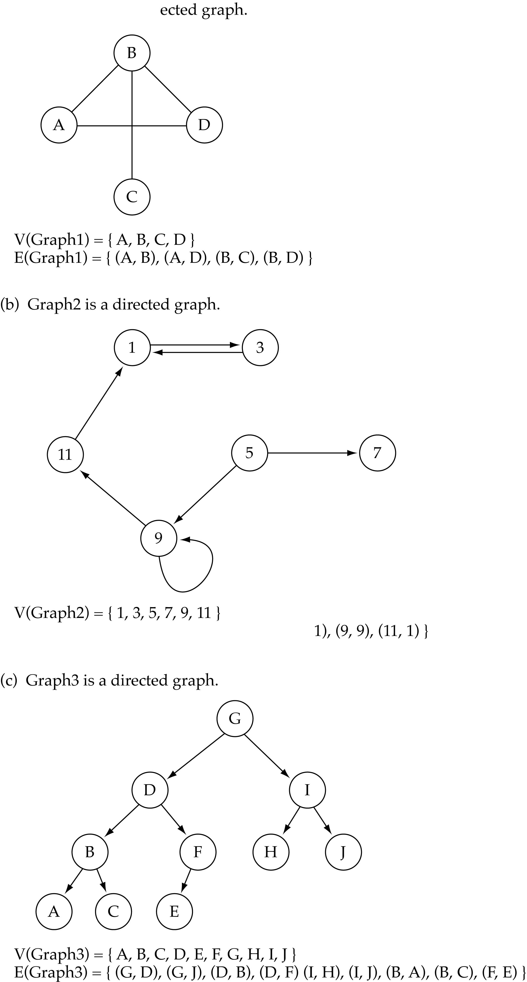
Trees vs Graphs
Trees are special cases of graphs!!

Slide 7
Graph Terminology
The length of a path in graph is the number of edges, equals to n-1.
A path from a vertex to itself has length 0.
Path(v,v) is referred to as a loop.
When all vertices are distinct, except that the first and the last could be the same, it is Simple Path.
A cycle in a directed graph is a path of length at least 1, such that w₁ = w_{n}.

Slide 8
Graph Terminology
Adjacent nodes: two nodes are adjacent if they are connected by an edge
Path: a sequence of vertices that connect two nodes in a graph
Complete graph: a graph in which every vertex is directly connected to every other vertex
5 is adjacent to 7
7 is adjacent from 5

Slide 9
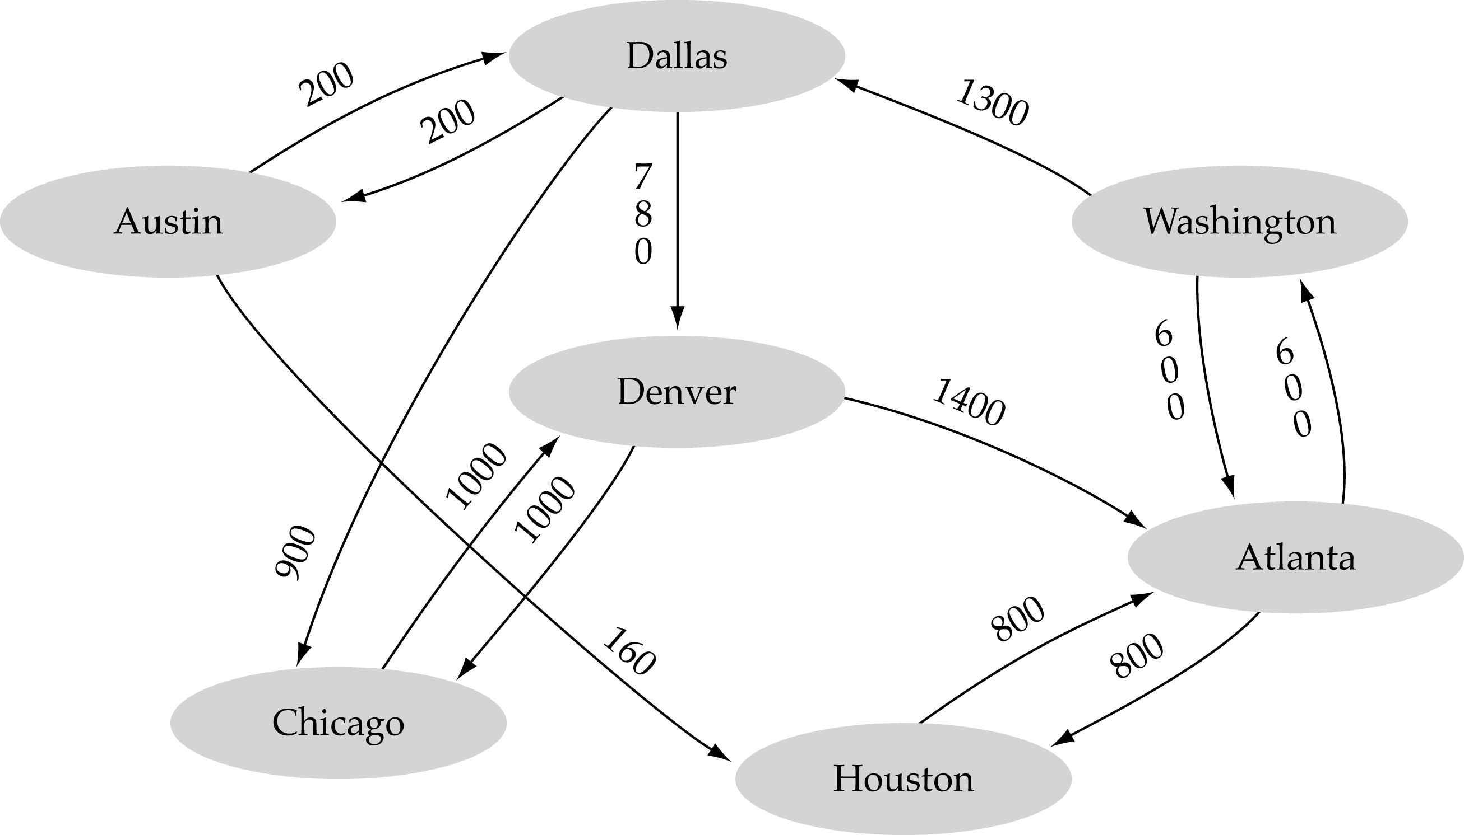
Graph terminology (cont.)
Weighted graph: a graph in which each edge carries a value

Slide 10
Static Graph implementation
Array-based implementation
A 1D array is used to represent the vertices
A 2D array (adjacency matrix) is used to represent the edges

Slide 11
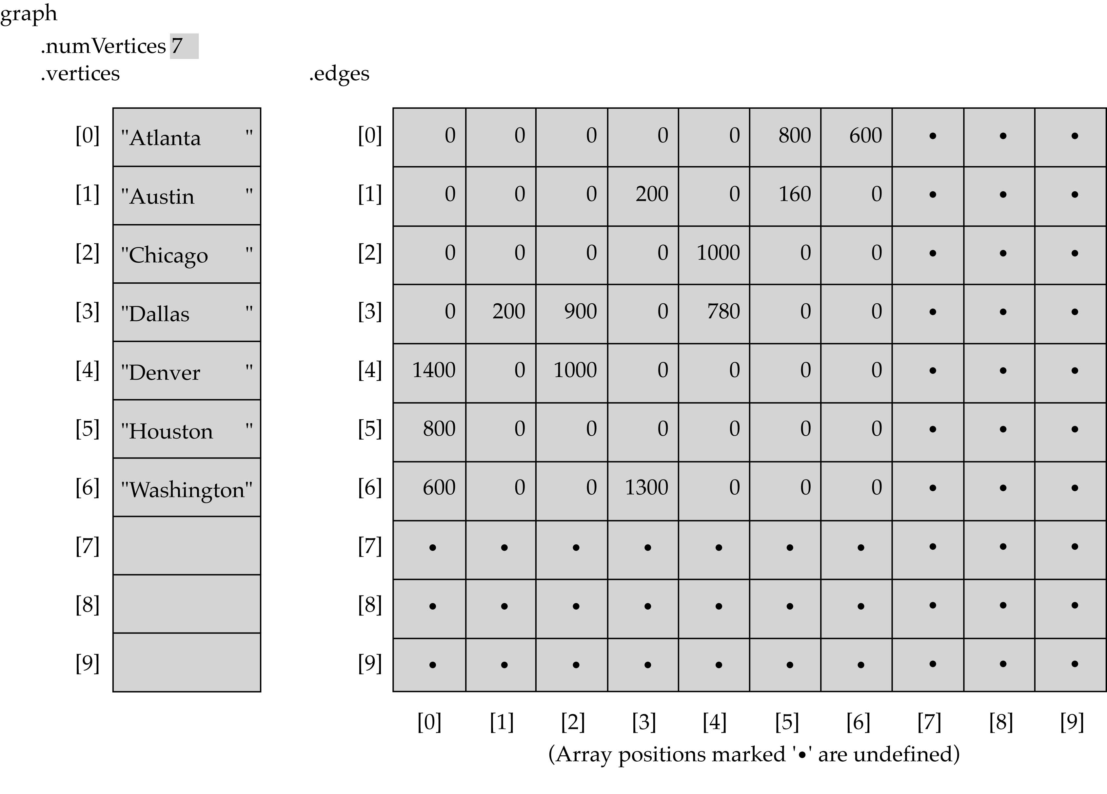
Array-based implementation

Slide 12
Adjacency Matrix?
1
2
4
5
3
6
7

Slide 13
 | 1 | 2 | 3 | 4 | 5 | 6 | 7
1 | 0 | 1 | 1 | 1 | 0 | 0 | 0
2 | 0 | 0 | 0 | 1 | 1 | 0 | 0
3 | 0 | 0 | 0 | 0 | 0 | 1 | 0
4 | 0 | 0 | 1 | 0 | 0 | 1 | 1
5 | 0 | 0 | 0 | 1 | 0 | 0 | 1
6 | 0 | 0 | 0 | 0 | 0 | 0 | 0
7 | 0 | 0 | 0 | 0 | 0 | 1 | 0

Slide 14
Static Implementation
class SGraph
{
private:
int noOfVertices;
Bool *aMatrix;
public:
SGraph(int nv) //creates adjacency matrix to represent graph.
{
noOfVertices = nv;
//Dynamically creates rows of two dimensional array aMatrix = new Bool *[noOfVertices];
//Dynamically creates columns of two dimensional array
for(int i = 0; i<noOfVertices; i++)
aMatrix[i] = new Bool[noOfVertices];
}
Continue on next slide…

Slide 15
Static Implementation
public:
insertGraph() //inserts graph in adjacency matrix
{
char choice;
for(int i = 0; i<noOfVertices; i++)
for(int j = 0; j<noOfVertices; j++)
{ cout<<“is there an edge b/w vertex”<<i<<“and”<<j;
cin>>choice;
if(choice == ‘y’ || choice == ‘Y’)
aMatrix[i][j] = 1;
else
aMatrix[i][j] = 0;
}
}
};

Slide 16
Print All the nodes of a graph
Apply one of the tree traversal technique (Pre, In, Post Order)
Were there any problems?
Develop the algorithm
Apply that algorithm on Adjacency Matrix implementation of the graph
1
2
4
5
3
6
7

Slide 17
Graph implementation (cont.)
Linked-list implementation
A 1D array is used to represent the vertices
A list is used for each vertex v which contains the vertices which are adjacent from v (adjacency list)

Slide 18
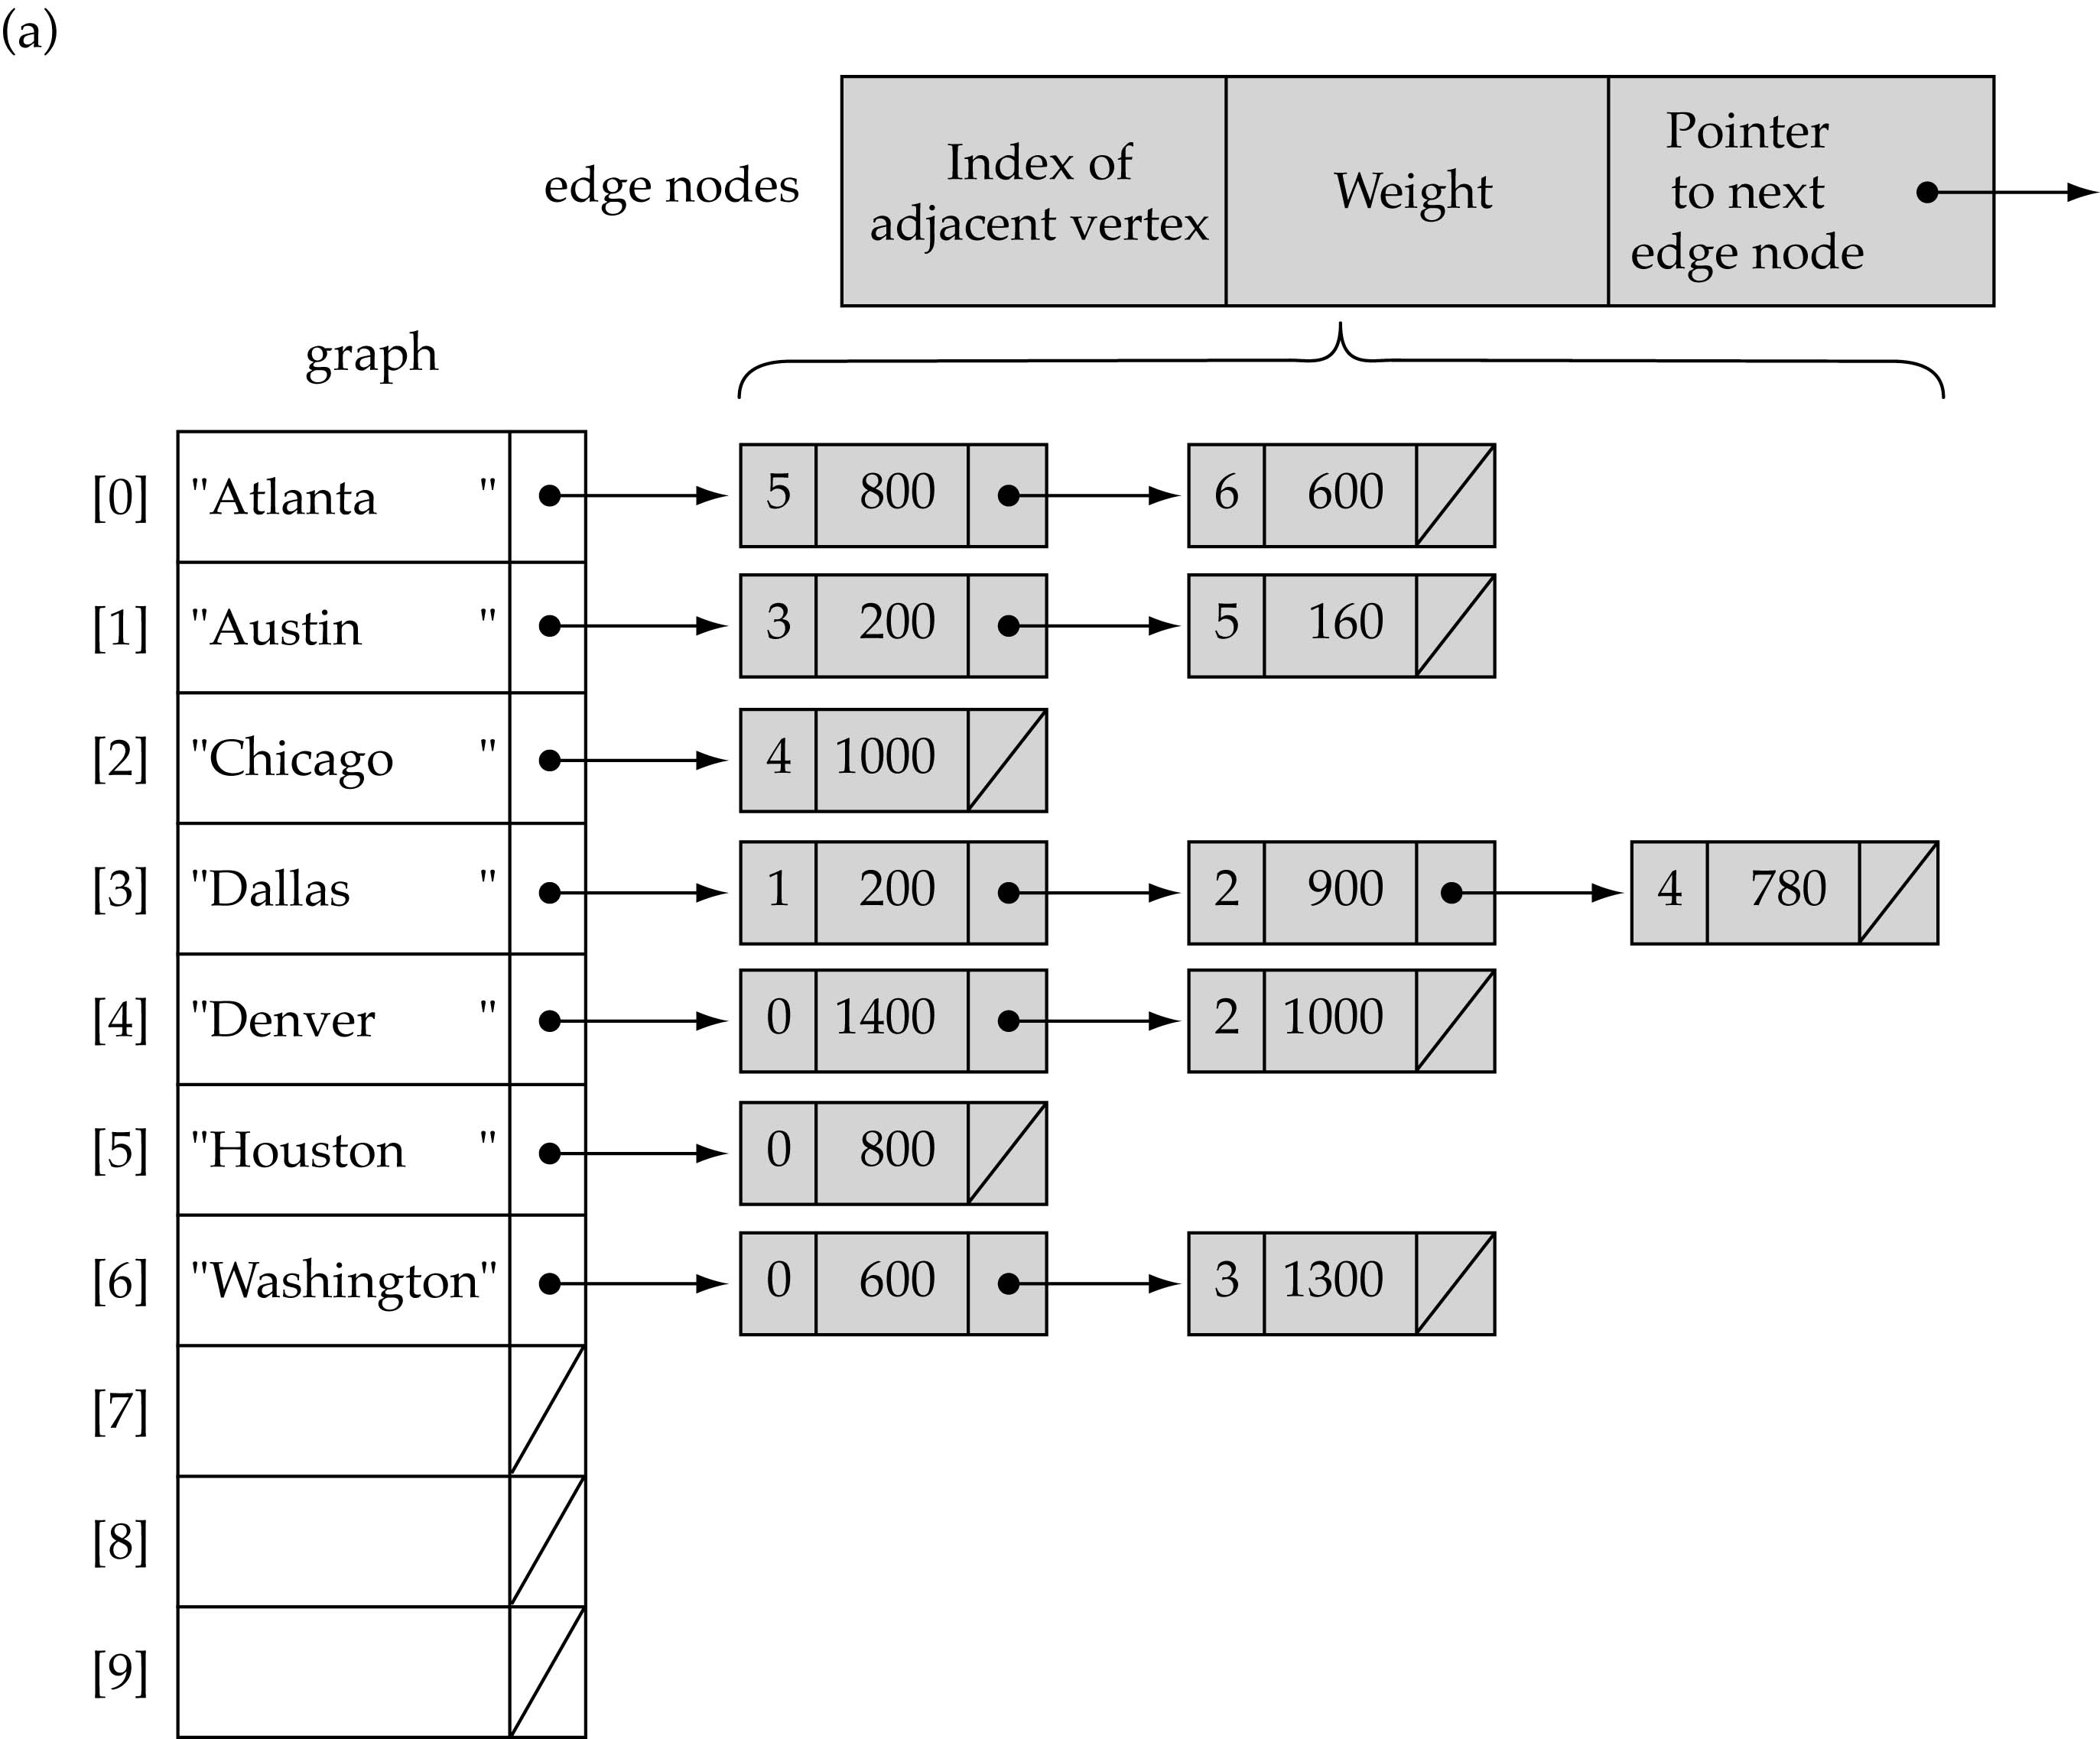
Linked-list implementation

Slide 19
Dynamic Implementation
public class DGraph
{
private:
int noOfVertices;
LinkedList *aList;
public:
//creates adjacency list to represent graph
DGraph(int nv)
{
noOfVertices = nv;
aList = new LinkedList[noOfVertices];
}
Continue on next slide…

Slide 20
Dynamic Implementation
//inserts graph in adjacency list
insert()
{ for(int i = 0; i<noOfVertices; i++)
{ int vertexNo;
cout<<“Enter the number of vertex adjacent to vertex” <<i<<“Enter –1 to terminate”;
cin>>vertexNo;
while(vertexNo != -1)
{ aList[i].addToTail(vertexNo);
cin>>vertexNo;
}
}
}
};

Slide 21
Adjacency Matrix vs. Adjacency List representation
Adjacency matrix
Good for dense graphs
Connectivity between two vertices can be tested quickly
Adjacency list
Good for sparse graphs
Vertices adjacent to another vertex can be found quickly

Slide 22
Graph searching
Problem: find a path between two nodes of the graph (e.g., Austin and Washington)
Methods: Depth-First-Search (DFS) or Breadth-First-Search (BFS)

Slide 23
Graph Traversals
Traversing a graph consists of visiting each vertex only one time.
We can traverse the graph by two ways:
Depth first search
Breadth first search

Slide 24
Graph Traversals (Depth first search)
This strategy proceeds along a path from vertex v as deeply into the graph as possible.
This means that after visiting v, the algo tries to visit any unvisited vertex adjacent to v.
When the traversal reaches a vertex which has no adjacent vertex, it back tracks and visits an unvisited adjacent vertex.
Stack can be used to help in back tracking.
Similar to Preorder Tree Traversal.

Slide 25
Depth first search
v
u
w
x
q
t
r
s
vuqrstwx

Slide 26
Graph Traversals (Depth first search algorithm)
Declare an array visited of type Boolean and initialize it to false.
Each index of this array indicates whether a particular vertex is visited or not.

Slide 27
Depth first search algorithm
depthFirstSearch(int TotalVertices)
{
boolean *visited = new int[TotalVertices];
for(int i = 0; i < TotalVertices; i++)
visited[ i ] = false;
while there is a vertex v which is not visited
DFS(v, visited)
}

Slide 28
Depth first search algorithm
DFS(Vertex v, Boolean visited[ ])
{ Stack s;
s.push(v);
visited[v] = true;
while(!s.isempty())
{ if(no adjacent vertices exist)
v = s.pop();
else
{ for each unvisited vertex u adjacent to v
s.push(u);
visited[u] = true;
}
}
};

Slide 29
Issues
DFS does not specify the order in which adjacent nodes should be visited.
Visit the vertices adjacent to v in alphabetical order.

Slide 30
Graph Traversals (Breadth first search)
It is basically a level order traversal.
After visiting a given vertex v, this strategy visits every vertex adjacent to v at the same level.
Traverses the graph in breadth, from left to right.
Queue is used to keep track of the nodes/vertices.

Slide 31
Graph Traversals (Breadth first search)
v
u
w
x
q
t
r
vuwxqtrs
s

Slide 32
Breadth first search algorithm
BFS(Vertex v)
{
Add V to Queue & mark it visited
While (Queue not Empty)
{ Remove Vertex from Queue & call it w
for (each unvisited vertex u adjacent to w) mark u visited
add u in Queue
}
End
}

Slide 33
Breadth First Traversal Example
A
C
D
B
E
I
H
F
G

Slide 34
Breadth First Traversal Example
Queue
A
C
B
C
D
B
E
I
H
F
G

Slide 35
Breadth First Traversal Example
Dqueue C
A
B
C
D
B
E
I
H
F
G

Slide 36
Breadth First Traversal Example
Enqueu D
A
B
D
C
D
B
E
I
H
F
G

Slide 37
Breadth First Traversal Example
Dqueue B
A
D
C
D
B
E
I
H
F
G

Slide 38
Breadth First Traversal Example
Enqueue E, I, H
A
D
E
I
H
C
D
B
E
I
H
F
G

Slide 39
Breadth First Traversal Example
Dqueue D
A
E
I
H
C
D
B
E
I
H
F
G

Slide 40
Breadth First Traversal Example
Dqueue E
A
I
H
C
D
B
E
I
H
F
G

Slide 41
Breadth First Traversal Example
Enqueue F, G
A
I
H
F
G
C
D
B
E
I
H
F
G

Slide 42
Breadth First Traversal Example
Dqueue I
A
H
F
G
C
D
B
E
I
H
F
G

Slide 43
Breadth First Traversal Example
Dqueue I
A
H
F
G
C
D
B
E
I
H
H already in queue i.e. visited
F
G

Slide 44
Breadth First Traversal Example
Dqueue H
A
F
G
C
D
B
E
I
H
F
G

Slide 45
Breadth First Traversal Example
Dqueue F
A
G
C
D
B
E
I
H
F
G

Slide 46
Breadth First Traversal Example
Dqueue G
A
C
D
B
E
I
H
F
G

Slide 47
Applications of Graphs
Topological Sorting
Spanning Trees
Shortest Path
Traveling Salesperson
Four Color Problem

Slide 48
Graph Implementation
Following methods can be defined while implementing a Static or Dynamic Graph:
void MakeEmpty();
bool IsEmpty();
bool IsFull();
void AddVertex(VertexType);
void AddEdge(VertexType, VertexType, int);
void DeleteVertex(VertexType);
void DeleteEdge(VertexType, VertexType, int);
void ReplaceVertex(VertexType, VertexType);
int WeightIs(VertexType, VertexType);
void ClearMarks();
void MarkVertex(VertexType);
bool IsMarked(VertexType);
void DFS(VertexType);
void BFS(VertexType);

